Slide 1
Automatic Depth Camera Calibration
Mihai Bace
mihai.bace@epfl.ch
Supervisors: Julien Pilet, Vincent Lepetit

Slide 2
Contents
Project motivation
How?
Steps
Data acquisition
Color filtering
Difference between Gaussian blurs
Pattern detection: template matching
Collect Correspondences
Calibration and Results
Comparison to Kinect’s calibration

Slide 3
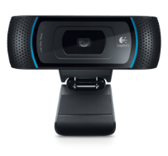
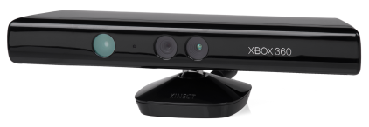

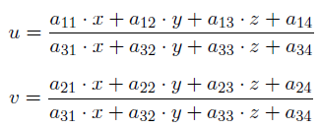
Project motivation
What is the relationship between them?
Calibrate a 3D camera with respect to a conventional 2D camera
We want to be able to project a 3D point to a 2D point
Determine the calibration matrix
Project a 3D point (x,y,z) to a 2D point (u,v)

Slide 4
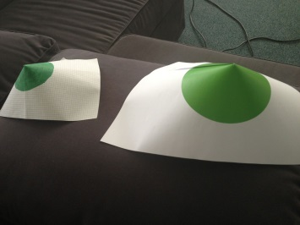
How?
For the process to be automatic:
Create a pattern
Detect the pattern in the 3D environment and the 2D environment
Feed the collected points to the calibrator
Calibrate!
The result of the calibration will be the A matrix which we can use to project any point from 3D to 2D

Slide 5
Steps
1. Get depth map from the Kinect, RGB image from the webcam and, RGB image from the Kinect
2. Color filtering on the Kinect’s RGB image & webcam’s RGB image
3. Filtering on the depth map based on filtering of the RGB image from the Kinect
4. Subtract two consecutive Gaussian blurs on the RGB images
5. Template matching on the RGB images
6. Template matching on the depth image
7. Collect correspondences
8. Minimize calibration error and eliminate outliers
9. Final result

Slide 6
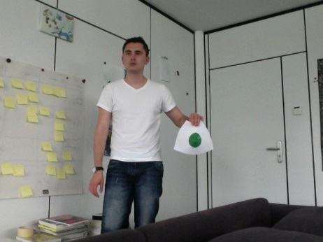
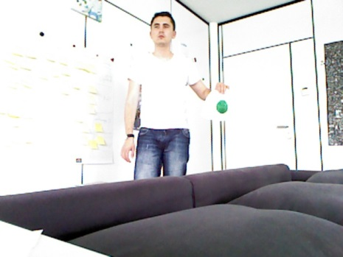
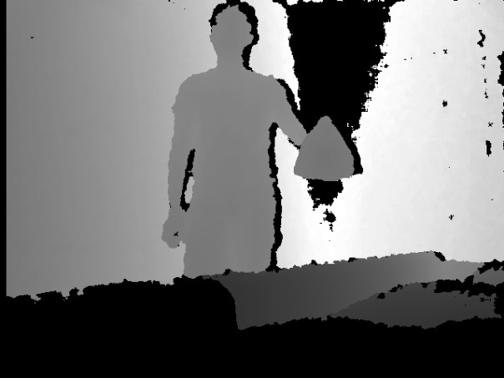
Data acquisition
Obtain RGB images from the webcam and the Kinect
Obtain depth map from the Kinect

Slide 7

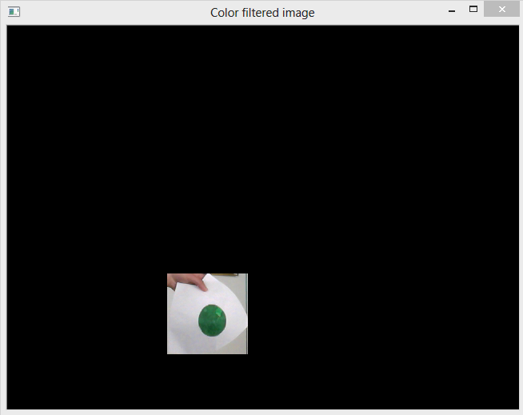
Color Filtering
Try to isolate the pattern from the rest of the image
Filter by color!
Color mask
RGB image filtered using the color mask

Slide 8
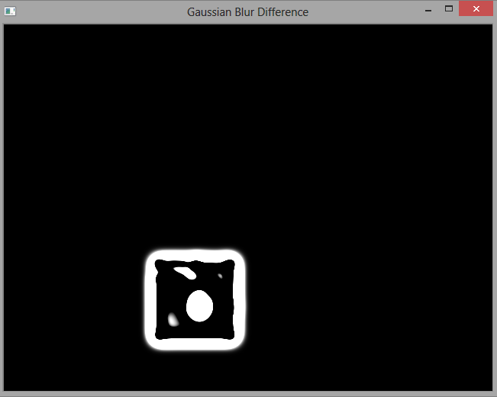
Subtract consecutive Gaussian blurs
Cannot do pattern detection directly on the RGB image
Subtract two consecutive Gaussian blurs do be able to isolate the pattern
As input we use the RGB image filtered by color
A clear disc shaped pattern is visible!

Slide 9
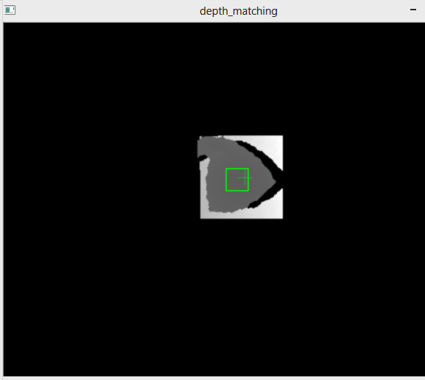
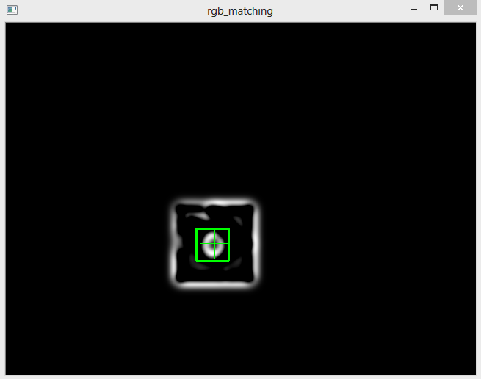
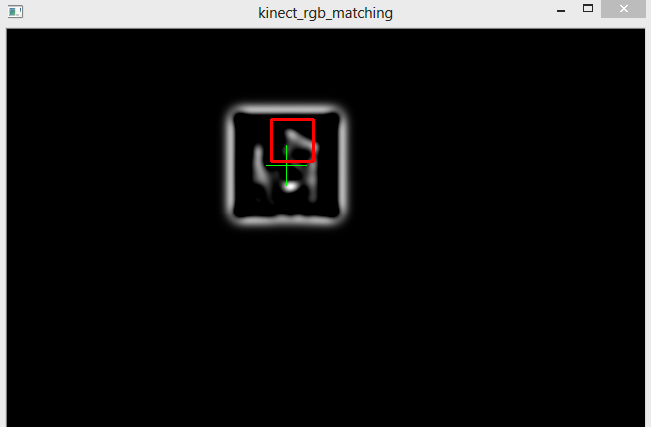
Template matching
On the depth image
On the RGB Images
Green – valid
Red – incorrect

Slide 10
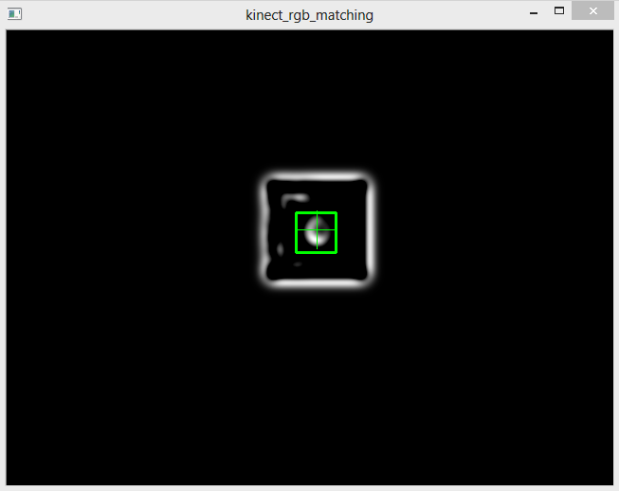
Collect correspondences
Green cross: median point from color detection
Collect the points in the center of the template
Extra validation criteria: check the points detected by the Kinect using the Kinect’s default calibration

Slide 11
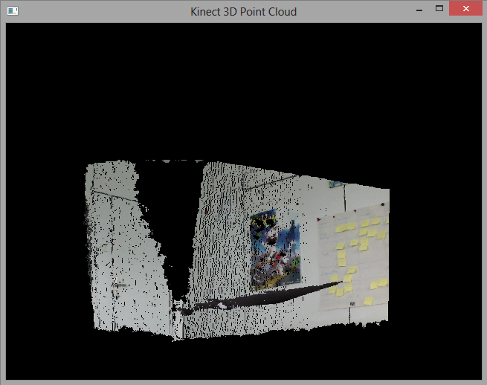
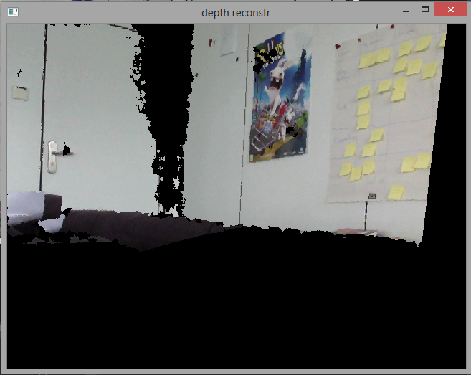
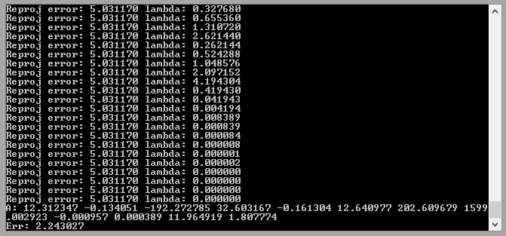
Calibration and Results
Iterative process: try to remove outliers
Repeat until reprojection error < 2-3 pixels
3D Point cloud
Depth image color reconstruction
Iterative
calibration

Slide 12
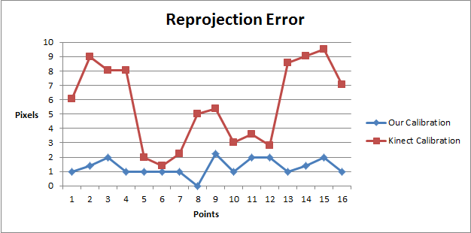
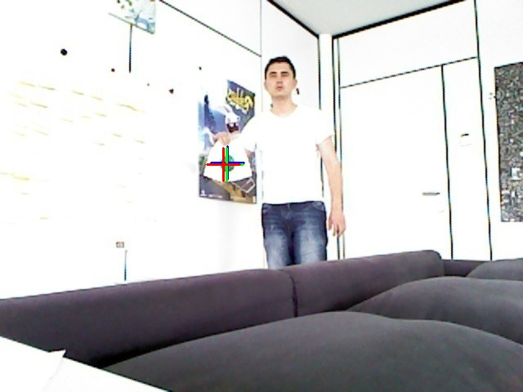
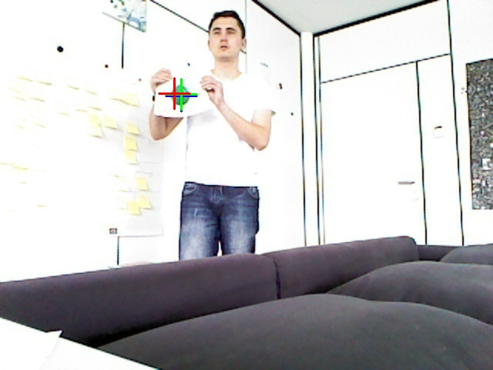
Comparison to Kinect’s calibration
Blue cross: detection result
Red cross: reprojection using Kinect’s calibration
Green cross: reprojection using our calibration

Slide 13

Thank you!
Questions?

Slide 14
References
Zhengyou Zhang, A Flexible New Technique for Camera Calibration. Microsoft Research, One Microsoft Way, Redmond, WA 98052-6399, USA
OpenCV Documnetation, http://docs.opencv.org/
OpenGL Documnetation, http://www.opengl.org/documentation/
OpenGL Camera Part 3, http://www.swiftless.com/tutorials/opengl/camera3.html, Swiftless Tutorials, Game Programming and Computer Graphics Tutorials
Microsoft Kinect SDK documnetation, http://msdn.microsoft.com/en-us/library/hh855366.aspx, MSDN Natural User Interface
Edward Zhang, Kinect SDK Tutorials, http://www.cs.princeton.edu/~edwardz/tutorials/index.html, Princeton University
Jared St. Jean, Kinect Hacks, Tips and Tools for Motion and Pattern Detection, O'REILLY
Contact:
Mihai Bace, mihai.bace@epfl.ch

